Slide 1

Chapter 3
Data and Signals

Slide 2
Data and Signals
Information can be voice, image, numeric data, characters, code, picture, and so on
To be transmitted, information must be into electromagnetic signals.

Slide 3
3.1 ANALOG AND DIGITAL
Data can be analog or digital. The term analog data refers to information that is continuous; digital data refers to information that has discrete states. Analog data take on continuous values. Digital data take on discrete values.
Topics discussed in this section:
Analog and Digital Data
Analog and Digital Signals
Periodic and Nonperiodic Signals

Slide 4
Analog and Digital Signals
Analog signal
  Having infinitely many levels of intensity over a period of time
  As the wave moves from value A to value B, it passes through and includes an infinite number of values along its path.
Digital signal
  Can have only a limited number of defined values

Slide 5
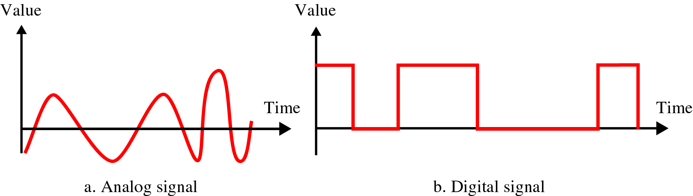
Analog and Digital Signals (cont’d)
Comparison of analog and digital signals

Slide 6
Aperiodic and periodic signals
Periodic signals(주기신호)
  ~ consists of a continuously repeated pattern.
The periodic of a signal(T) is expressed in seconds.
A cycle : the completion of one full pattern

Slide 7
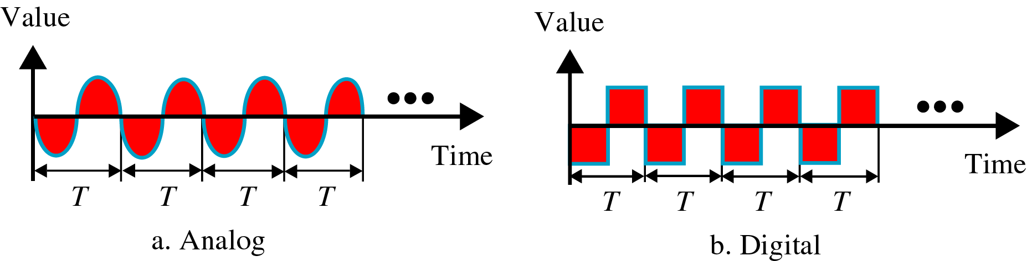
Aperiodic and periodic signals (cont’d)
Example of periodic signals

Slide 8
Aperiodic and periodic signals (cont’d)
Aperiodic signals(비주기 신호)
  ~ changes constantly without exhibiting a pattern or cycle that repeat over time.
  ~ signal has no repetitive pattern.
In data communication, we commonly use periodic analog signals and aperiodic digital signals

Slide 9

3.2 PERIODIC ANALOG SIGNALS
Periodic analog signals can be classified as simple or composite. A simple periodic analog signal, a sine wave, cannot be decomposed into simpler signals. A composite periodic analog signal is composed of multiple sine waves.
  the sine wave is the most fundamental form of a periodic analog signal.
Topics discussed in this section:
Sine Wave
Wavelength
Time and Frequency Domain
Composite Signals
Bandwidth

Slide 10
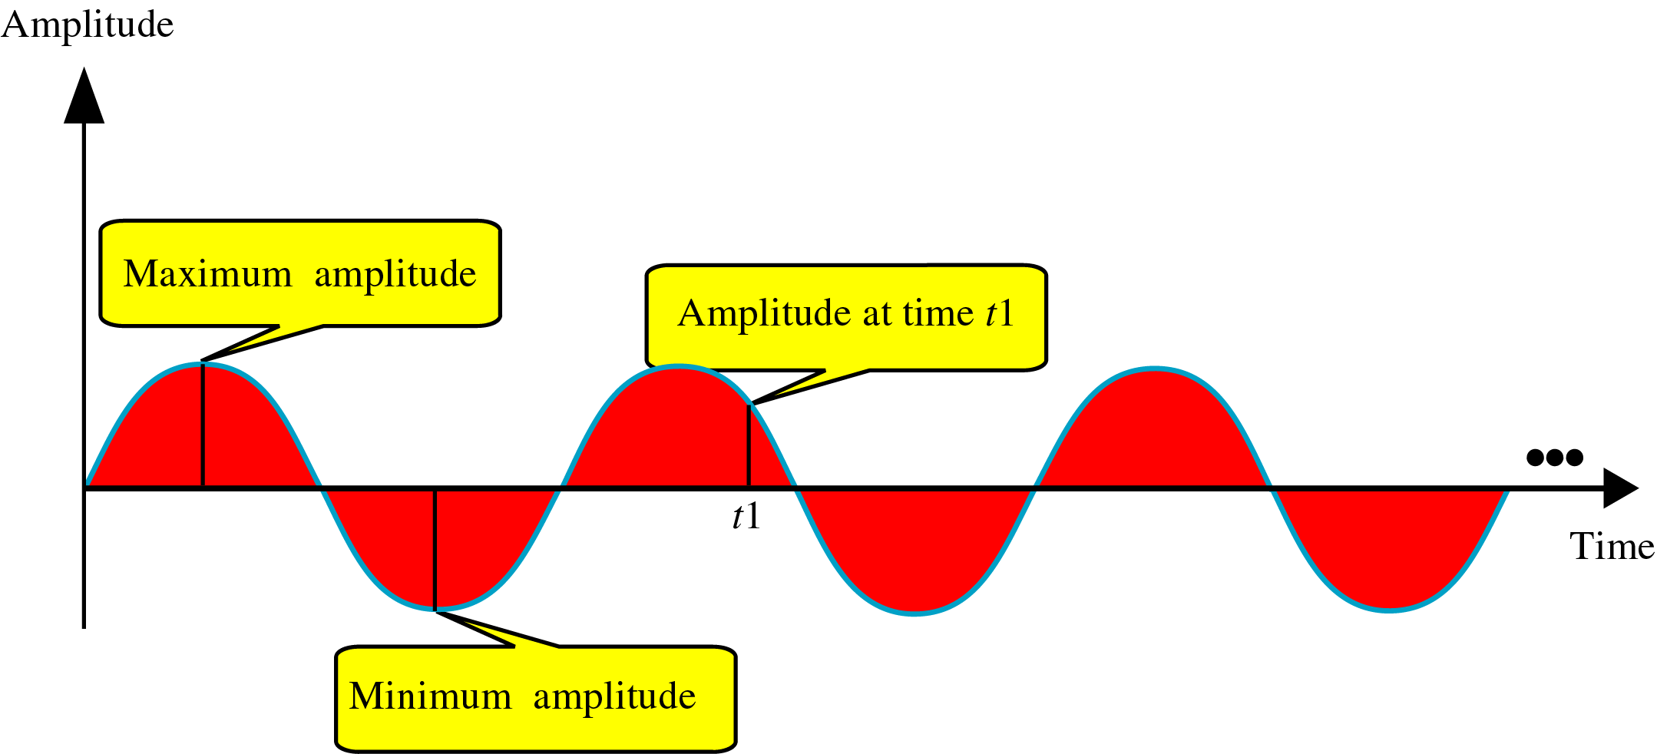
Analog signals(cont’d)
Sine Wave (정현파)

Slide 11

Analog signals(cont’d)
Sine wave can be fully described by three characteristics
  amplitude(진폭)
  period(주기), frequency(주파수)
  phase(위상)

Slide 12
Analog signals(cont’d)
Amplitude(진폭)
  ~ refer to the height of the signal.
  특정 순간의 신호 값; voltage(전압), amperes(전류), watts(전력)
Period(주기), Frequency(주파수)
  Period
    ~ refers to the amount of time, in seconds, a signal needs to complete one cycle.
  Frequency
    ~ refers to number of periods a signal makes over the course of one second.(주기의 역수(1/t), 초당 주기의 반복 횟수)

Slide 13
Analog signals(cont’d)
    Frequency=1/Period, Period=1/Frequency
    f = 1 / T , T = 1 / f
  Unit of Frequency
    ~ is expressed in Hertz(Hz).
  Unit of Period
    ~ is expressed in seconds.

Slide 14

Analog signals (cont’d)
Figure 3.3 Two signals with the same phase and frequency,
but different amplitudes

Slide 15

Analog signals (cont’d)
Figure 3.4 Two signals with the same amplitude and phase,
but different frequencies

Slide 16

Analog signals(cont’d)
Table 3.1 Units of period and frequency

Slide 17
Analog signals(cont’d)
More about Frequency
  Frequency is rate of change with respect to time
  Change in a short span of time means high frequency.
  Change in a long span of time means low frequency.
Two Extremes
  If a signal does not change at all, its frequency is zero.
  If a signal changes instantaneously, its frequency is infinity.

Slide 18
Analog signals(cont’d)
Phase(위상)
  ~ describes the position of the waveform relative to time zero(시간 0에 대한 파형의 상대적인 위치)

Slide 19
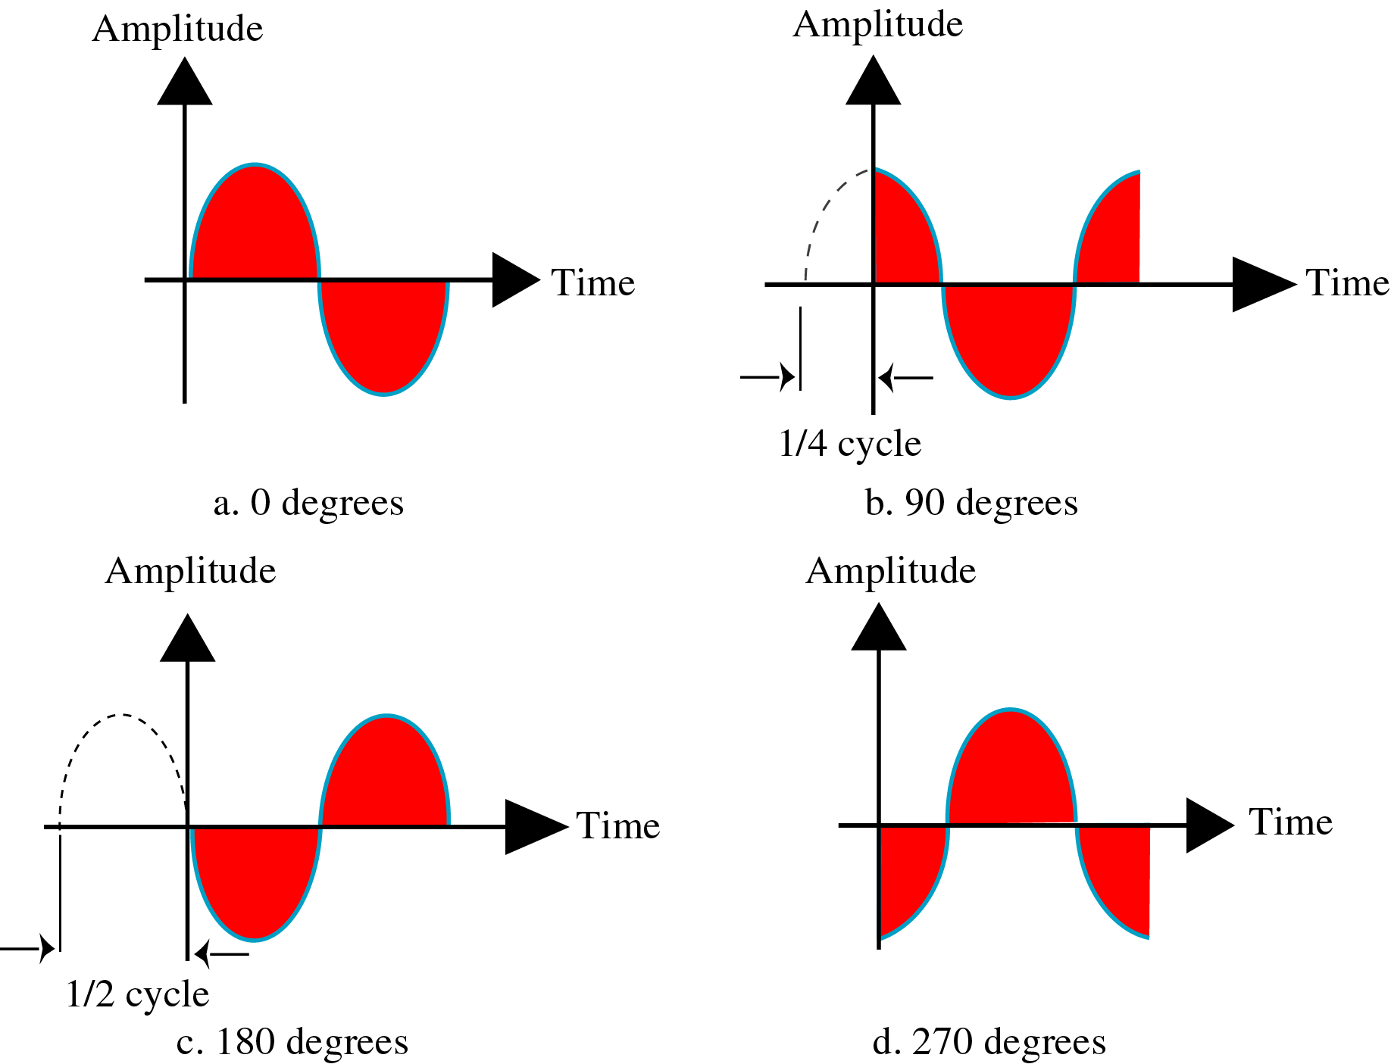
Analog signals(cont’d)
Relationship between different phases

Slide 20
Analog signals (cont’d)
Example 3.6 : A sine wave is offset one-sixth of a cycle with respect to time zero. What is its phase in degrees and radians?
Solution
  We know that one complete cycle is 360 degrees.
  Therefore, 1/6 cycle is
  (1/6) 360 = 60 degrees = 60 x (2π/360) rad = 1.046 rad
2pi radians equal to 360 degrees, thus 1 radian = 180/pi

Slide 21
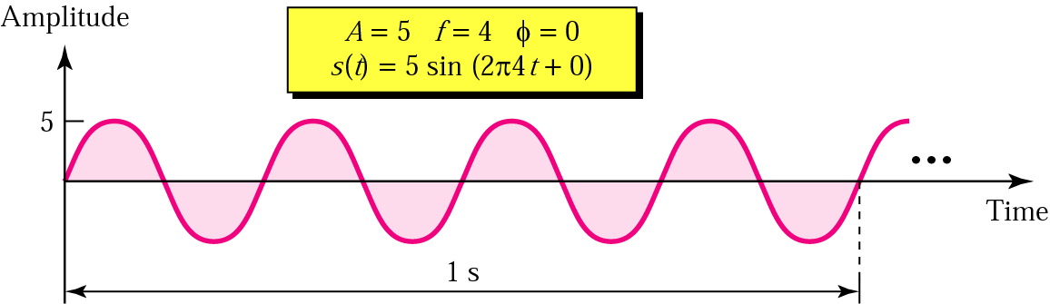
Analog signals(cont’d)
Sine wave examples
ft

Slide 22
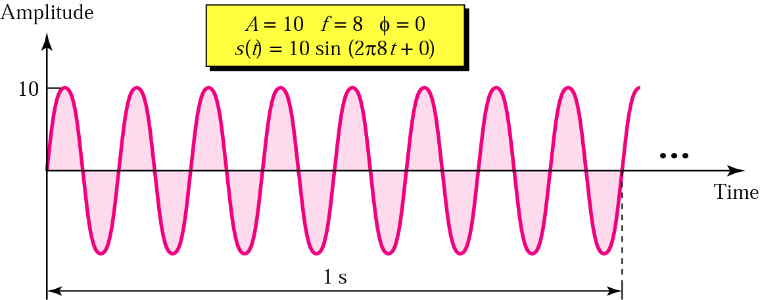
Analog signals(cont’d)
Sine wave examples
ft

Slide 23
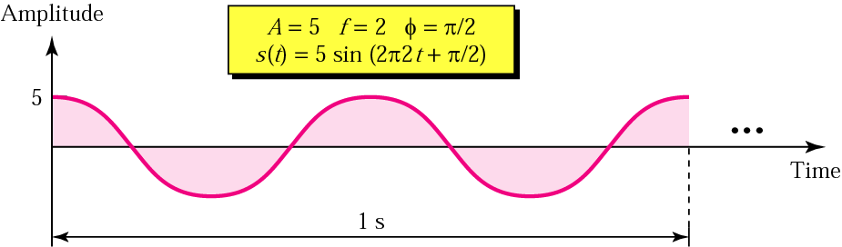
Analog Signals(cont’d)
Sine wave examples
ft

Slide 24
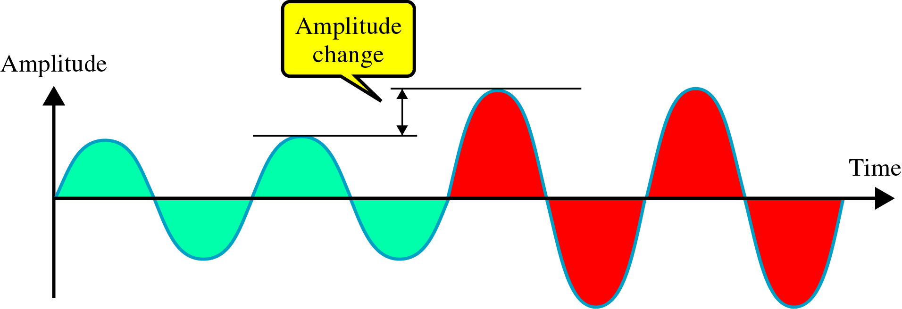
Analog signals(cont’d)
Amplitude change

Slide 25
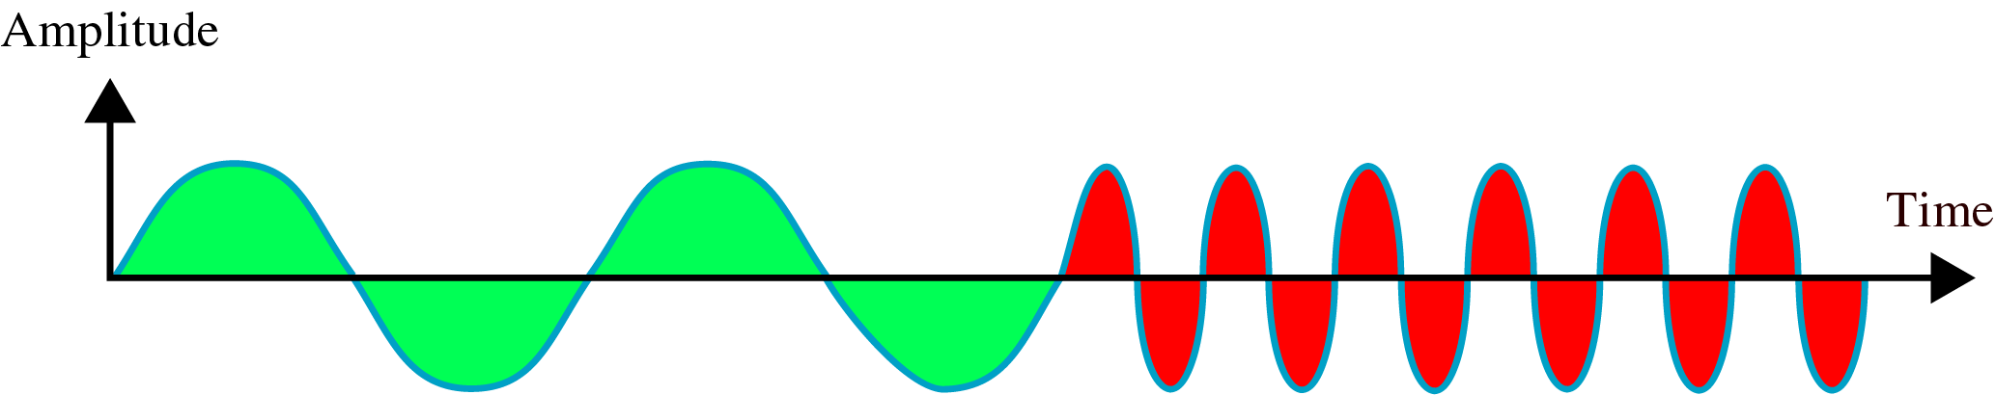
Analog signals(cont’d)
Frequency change

Slide 26
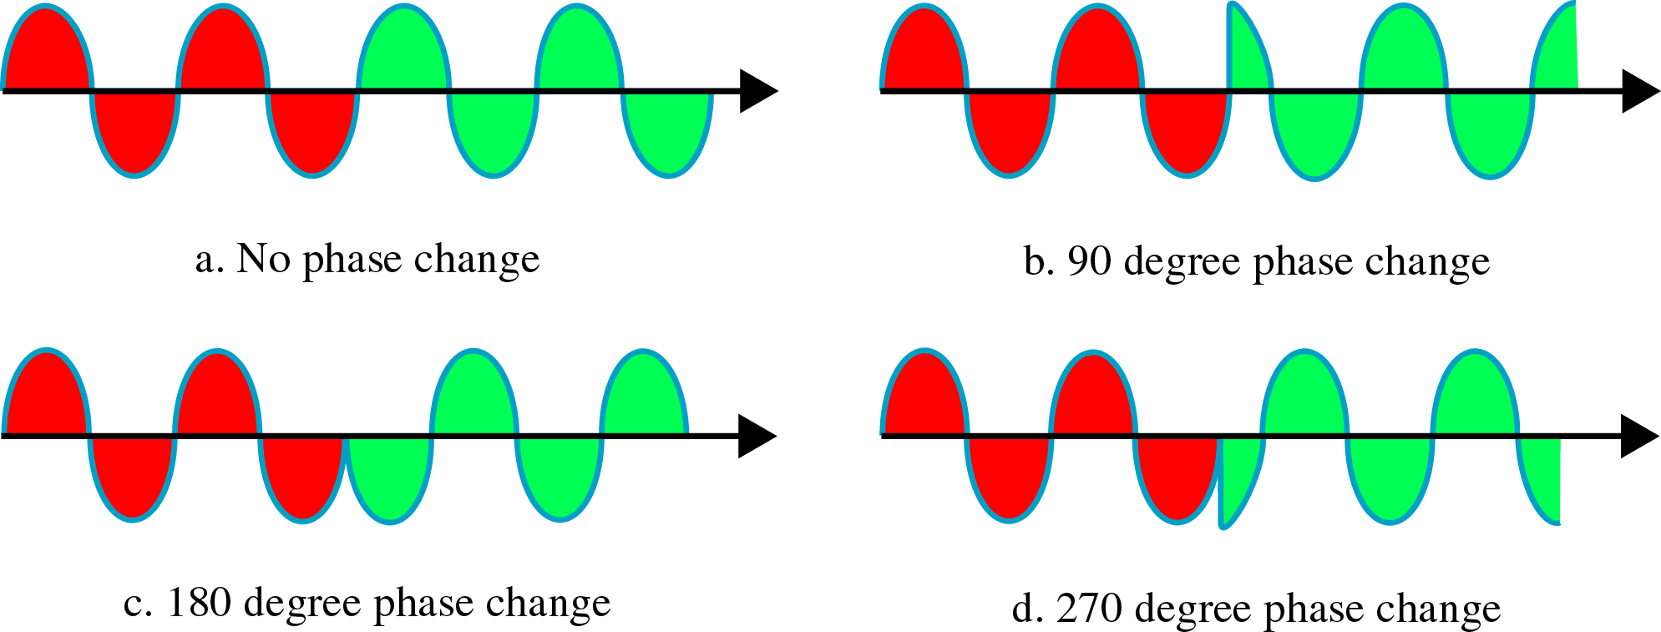
Analog signals(cont’d)
Phase change

Slide 27
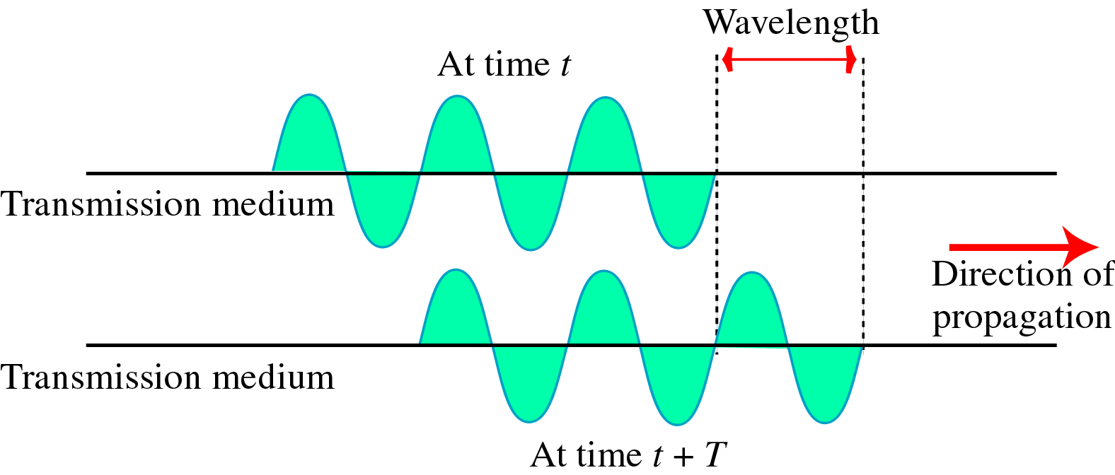
Analog signals(cont’d)
Wavelength = Lamda = c/f (propagation speed/frequency)

Slide 28
Analog signals(cont’d)
Time versus Frequency Domain
  Time Domain : instantaneous amplitude with respect to time.
  Frequency Domain : maximum amplitude with respect to frequency.

Slide 29
Analog signals(cont’d)
Time versus Frequency Domain
  Time Domain : instantaneous amplitude with respect to time.
  Frequency Domain : maximum amplitude with respect to frequency.

Slide 30
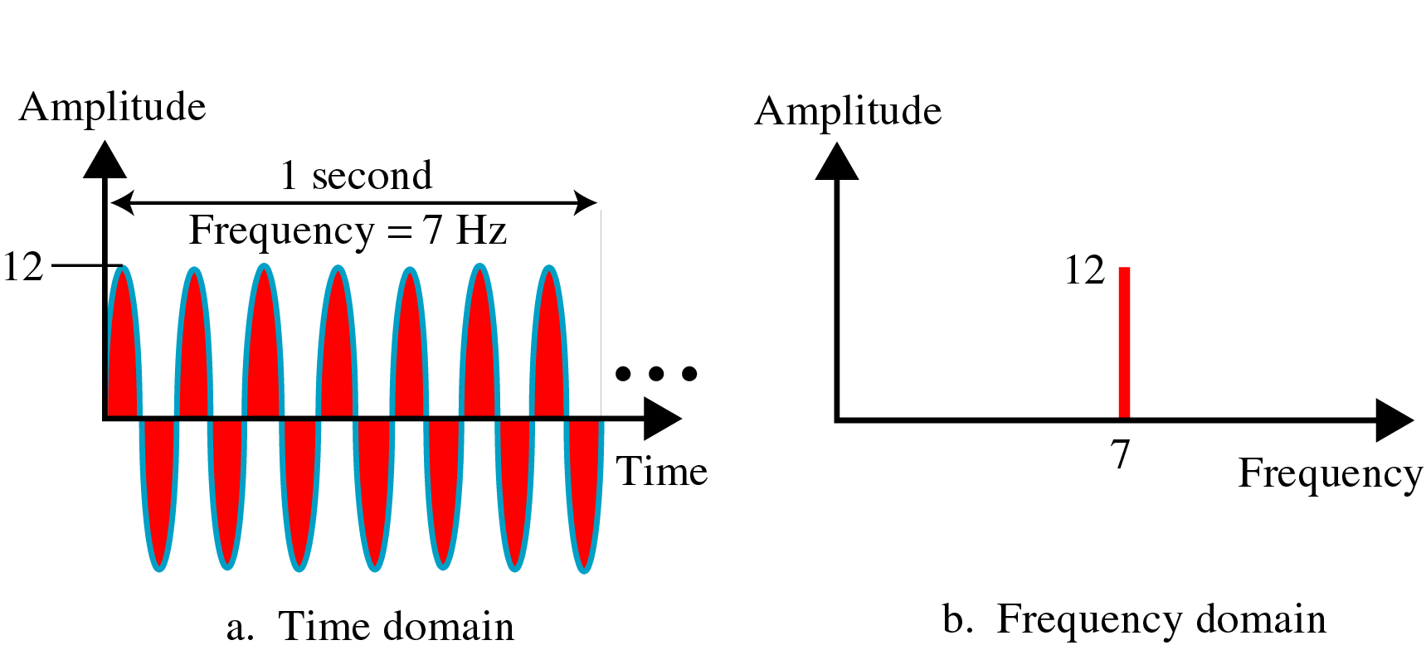
Analog signals(cont’d)
Time and Frequency domains
Peak value
Peak value

Slide 31

Analog signals(cont’d)
Figure 3.8 The time domain and frequency domain of three sine waves

Slide 32
Composite Signal
Composite Signal
  A single-frequency sine wave is not useful in data communications; we need to change one or more of its characteristics to make it useful.
  When we change one or more characteristics of a single-frequency signal, it becomes a composite signal made of many frequencies.

Slide 33
Composite Signal (cont’d)
According to Fourier analysis, any composite signal is a combination of simple sine waves with different frequencies, amplitudes, and phases. Fourier analysis is discussed in Appendix C.
If the composite signal is periodic, the decomposition gives a series of signals with discrete frequencies;
if the composite signal is nonperiodic, the decomposition gives a combination of sine waves with continuous frequencies.

Slide 34
Composite Signal (cont’d)
Figure 3.9 shows a periodic composite signal with frequency f. This type of signal is not typical of those found in data communications. We can consider it to be three alarm systems, each with a different frequency. The analysis of this signal can give us a good understanding of how to decompose signals.
Example 3.8

Slide 35

Composite Signal (cont’d)
Figure 3.9 A composite periodic signal

Slide 36

Composite Signal (cont’d)
Figure 3.10 Decomposition of a composite periodic signal in the time and
frequency domains

Slide 37
Composite Signal (cont’d)
Example 3.9
Figure 3.11 shows a nonperiodic composite signal. It can be the signal created by a microphone or a telephone set when a word or two is pronounced. In this case, the composite signal cannot be periodic, because that implies that we are repeating the same word or words with exactly the same tone.

Slide 38

Composite Signal (cont’d)
Figure 3.11 The time and frequency domains of a nonperiodic signal

Slide 39
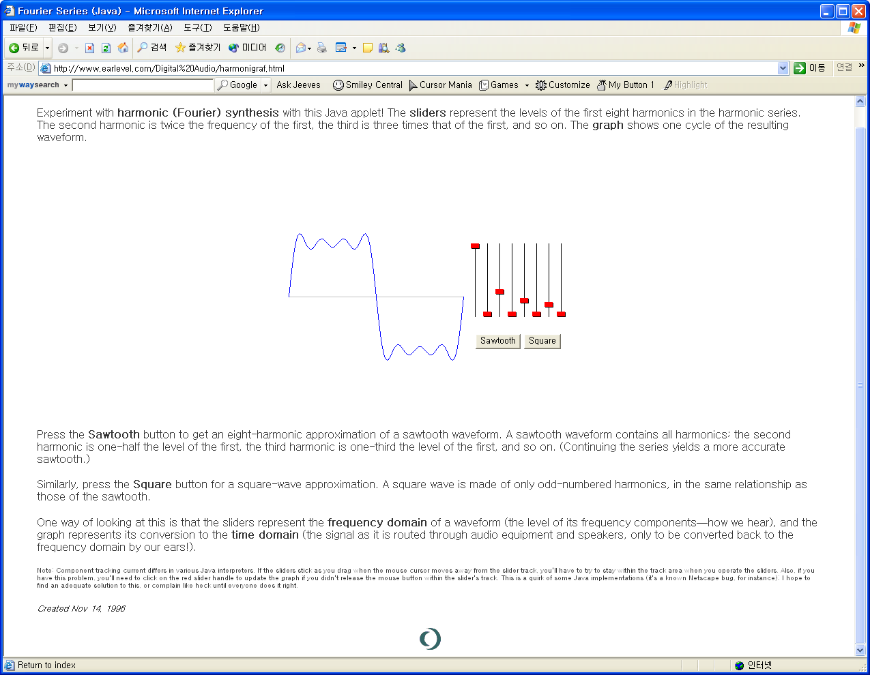
Composite Signal (cont’d)
An demonstration on Fourier
  http://www.earlevel.com/Digital%20Audio/harmonigraf.html

Slide 40
Bandwidth
Frequency Spectrum and Bandwidth
  The frequency spectrum of a signal is the combination of all sine wave signals that make signal.
  The bandwidth of a signal is the width of the frequency spectrum
    The bandwidth of a composite signal is the difference between the highest and the lowest frequencies contained in that signal.

Slide 41
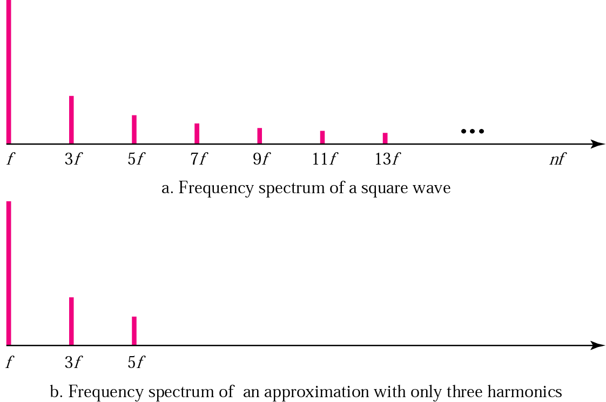
Bandwidth (cont’d)
Frequency Spectrum

Slide 42

Bandwidth (cont’d)
Figure 3.12 The bandwidth of periodic and nonperiodic composite signals

Slide 43
Bandwidth (cont’d)
Example 3.10
If a periodic signal is decomposed into five sine waves with frequencies of 100, 300, 500, 700, and 900 Hz, what is its bandwidth? Draw the spectrum, assuming all components have a maximum amplitude of 10 V.

Slide 44

Bandwidth (cont’d)
Figure 3.13 The bandwidth for Example 3.10

Slide 45
Bandwidth (cont’d)
Example 3.11
A periodic signal has a bandwidth of 20 Hz. The highest frequency is 60 Hz. What is the lowest frequency? Draw the spectrum if the signal contains all frequencies of the same amplitude.

Slide 46

Bandwidth (cont’d)
Figure 3.14 The bandwidth for Example 3.11

Slide 47
Bandwidth (cont’d)
Example 3.12
A nonperiodic composite signal has a bandwidth of 200 kHz, with a middle frequency of 140 kHz and peak amplitude of 20 V. The two extreme frequencies have an amplitude of 0. Draw the frequency domain of the signal.

Slide 48

Bandwidth (cont’d)
Figure 3.15 The bandwidth for Example 3.12

Slide 49
3.3 DIGITAL SIGNALS
In addition to being represented by an analog signal, information can also be represented by a digital signal. For example, a 1 can be encoded as a positive voltage and a 0 as zero voltage. A digital signal can have more than two levels. In this case, we can send more than 1 bit for each level.
Topics discussed in this section:
Bit Rate
Bit Length
Digital Signal as a Composite Analog Signal
Application Layer

Slide 50

Digital Signals
Figure 3.16 Two digital signals: one with two signal levels and the other
with four signal levels

Slide 51
Digital Signals (cont’d)
Example 3.16
A digital signal has eight levels. How many bits are needed per level? We calculate the number of bits from the formula
Each signal level is represented by 3 bits.

Slide 52
Digital Signals (cont’d)
Example 3.19
A digitized voice channel, as we will see in Chapter 4, is made by digitizing a 4-kHz bandwidth analog voice signal. We need to sample the signal at twice the highest frequency (two samples per hertz). We assume that each sample requires 8 bits. What is the required bit rate?
Solution
The bit rate can be calculated as

Slide 53
Digital Signals (cont’d)
Example 3.20
What is the bit rate for high-definition TV (HDTV)?
Solution
HDTV uses digital signals to broadcast high quality video signals. The HDTV screen is normally a ratio of 16 : 9. There are 1920 by 1080 pixels per screen, and the screen is renewed 30 times per second. Twenty-four bits represents one color pixel.
The TV stations reduce this rate to 20 to 40 Mbps through compression.

Slide 54
Digital Signals (cont’d)
Bit Length
  Bit Length = propagation speed x bit duration

Slide 55

Digital Signal as a Composite Analog Signal
Figure 3.17 The time and frequency domains of periodic and nonperiodic
digital signals

Slide 56

Transmission of Digital Signals
Transmission types of digital signals :
  Baseband and Broad-band transmission
Figure 3.18 Baseband transmission
A digital signal is a composite analog signal with an infinite bandwidth.

Slide 57

Transmission of Digital Signals (cont’d)
Figure 3.19 Bandwidths of two low-pass channels

Slide 58

Transmission of Digital Signals (cont’d)
Low-Pass Channel with Wide Bandwidth
Figure 3.20 Baseband transmission using a dedicated medium
Baseband transmission of a digital signal that preserves the shape of the digital signal is possible only if we have a low-pass channel with an infinite or very wide bandwidth.

Slide 59

Transmission of Digital Signals (cont’d)
Loss-Pass Channel with Limited Bandwidth
Figure 3.21 Rough approximation of a digital signal using the first harmonic
for worst case

Slide 60
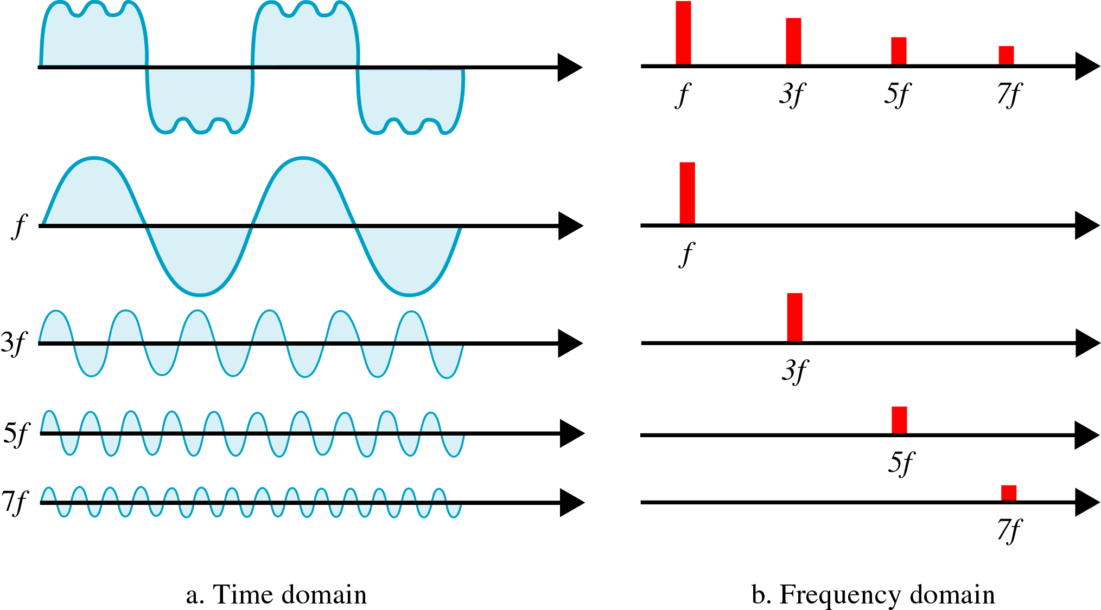
Transmission of Digital Signals (cont’d)
Complex waveform

Slide 61

Transmission of Digital Signals (cont’d)
Figure 3.22 Simulating a digital signal with first three harmonics

Slide 62
Transmission of Digital Signals (cont’d)
In baseband transmission, the required bandwidth is proportional to the bit rate;
if we need to send bits faster, we need more bandwidth.

Slide 63

Transmission of Digital Signals (cont’d)
Table 3.2 Bandwidth requirements
B = n/2
B = 3n/2
B = 5n/2

Slide 64

Broadband Transmission (Using Modulation)
Figure 3.23 Bandwidth of a bandpass channel
If the available channel is a bandpass channel, we cannot send the digital signal directly to the channel;
we need to convert the digital signal to an analog signal before transmission.

Slide 65

Broadband Transmission (Using Modulation)
Figure 3.24 Modulation of a digital signal for transmission on a bandpass
channel
using Carrier

Slide 66
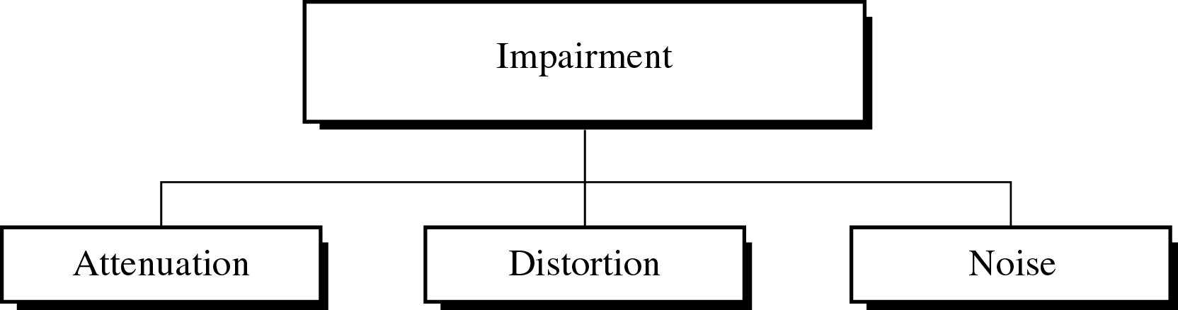
3.4 TRNSMISSION IMPAIRMENT
Transmission media are not perfect because of impairment in the signal sent through the medium
  Signal at the beginning and end of the medium are not same

Slide 67
Transmission Impairment
Attenuation
  means loss of energy
  When signal travels trough a medium, it losses some of it’s energy
  So, to compensate for this loss, amplifiers are used to amplify the signal
Decibel (dB)
  dB = 10 log₁₀ (p₂/p₁)

Slide 68
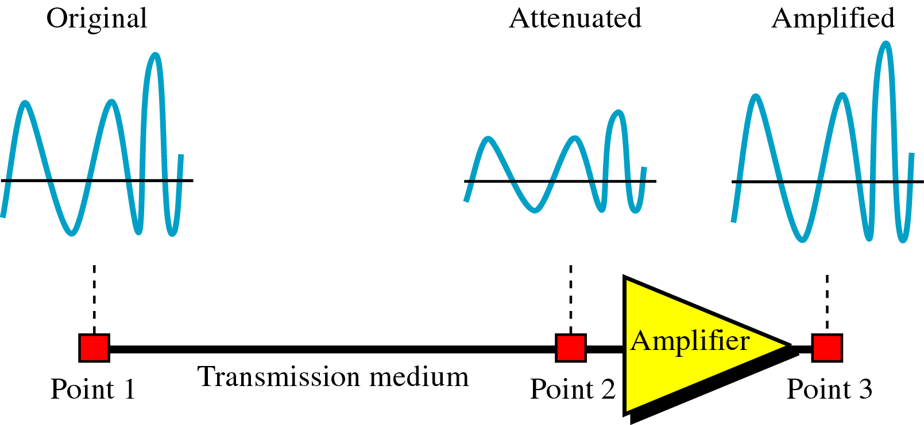
Transmission Impairment
If signal power is reduced to one-half.
  p₂ = (1/2) p₁ → 10 log₁₀ 0.5P₁ / p₁ = 10 log₁₀ 0.5 = -3 dB
If signal power is increased 10 times by AMP
  p₂ = (10) p₁ → 10 log₁₀ 10P₁ / p₁ = 10 log₁₀ 10 = 10 dB

Slide 69
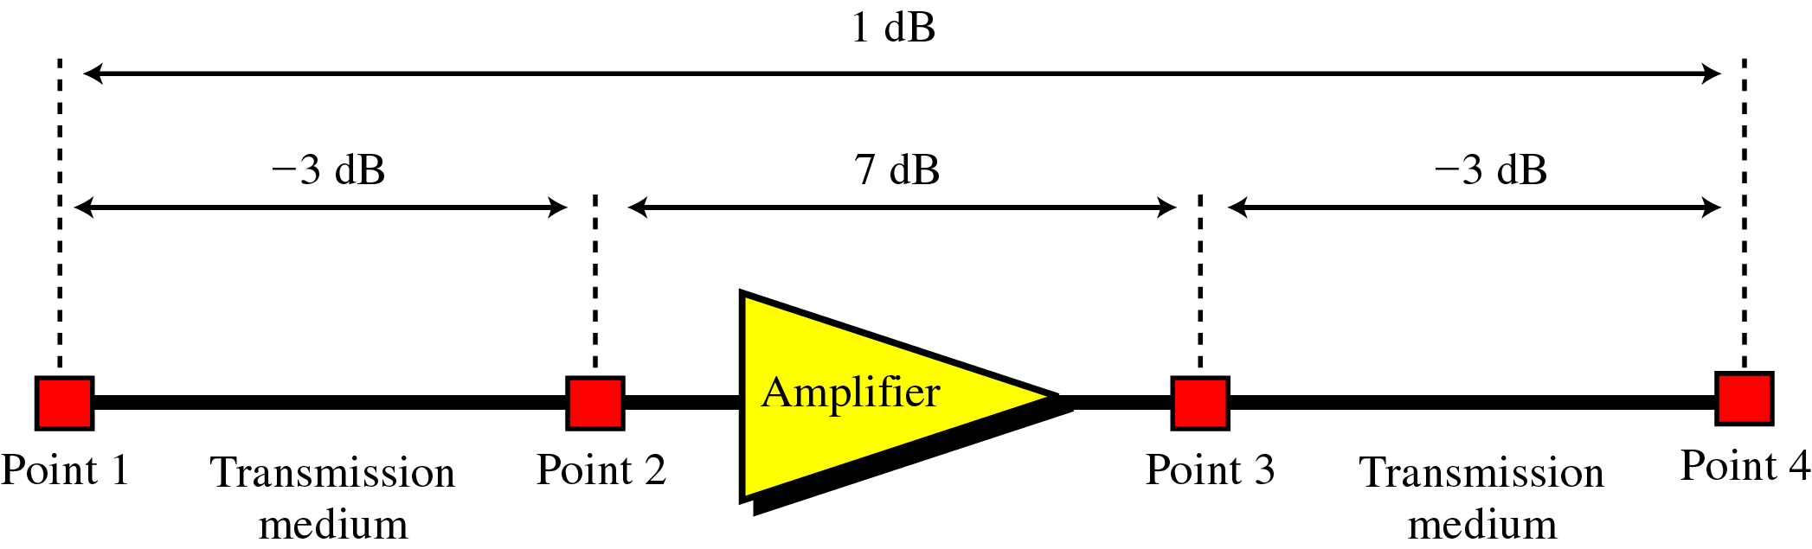
Transmission Impairment
dB at point 4 = -3 + 7-3 = +1

Slide 70

Transmission Impairment
Example 3.29
Sometimes the decibel is used to measure signal power in milliwatts. In this case, it is referred to as dB_{m} and is calculated as dB_{m} = 10 log₁₀ P_{m} , where P_{m} is the power in milliwatts. Calculate the power of a signal with dB_{m} = −30.
Solution
We can calculate the power in the signal as

Slide 71
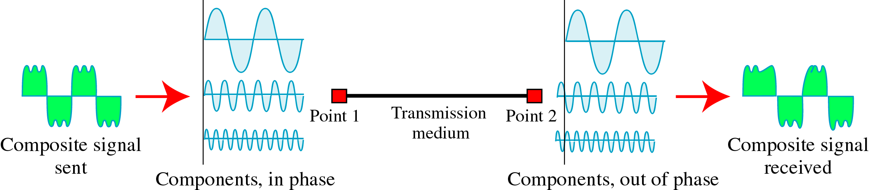
Transmission Impairment
Distortion
  Means that signal changes its form or shape

Slide 72
Transmission Impairment
Noise
  - Noise types
  thermal noise, induced noise, crosstalk and impulse noise
  Thermal noise : random motion of electrons
  Induced noise : from sources such as motors, appliances
  Crosstalk : the effect of one wire on the other
  Impulse noise : a spike that comes from power lines, lightning, and so on.

Slide 73
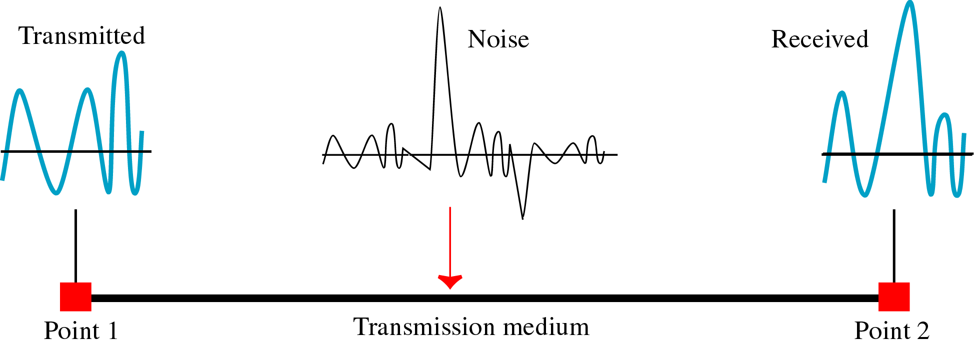
Transmission Impairment
noise

Slide 74

Signal to Noise Ratio
SNR= average signal power / average noise power
SNR_{dB} = 10 log ₁₀ SNR
Example 3.31
The power of a signal is 10 mW and the power of the noise is 1 μW; what are the values of SNR and SNR_{dB} ?
Solution
The values of SNR and SNR_{dB} can be calculated as follows:
1uW

Slide 75

Signal to Noise Ratio
Example 3.32
The values of SNR and SNR_{dB} for a noiseless channel are
We can never achieve this ratio in real life; it is an ideal.

Slide 76

Signal to Noise Ratio
Figure 3.30 Two cases of SNR: a high SNR and a low SNR

Slide 77
3.5 DATA RATE LIMITS
Data rate depends on three factors
  The available bandwidth
  The levels of signals we can use
  The quality of the channel (the level of the noise)
Noiseless channel : Nyquist Bit Rate
  Bit Rate = 2 x Bandwidth x log₂ L
  L : number of signal levels
Example 3.34
  Consider a noiseless channel with a bandwidth of 3000 Hz transmitting a signal with two signal levels. The maximum bit rate can be calculated as
  Bit Rate = 2 × 3000 × log₂ 2 = 6000 bps
Increasing the levels of a signal may reduce the reliability of the system.

Slide 78
Data Rate Limits
Noisy channel: Shannon Capacity
  Capacity = Bandwidth x log₂ (1 + SNR)
Example 3.37
Consider an extremely noisy channel in which the value of the signal-to-noise ratio is almost zero. In other words, the noise is so strong that the signal is faint. For this channel the capacity is calculated as
→
C = B log₂ (1 + SNR) = B log₂ (1 + 0)
= B log₂ (1) = B × 0 = 0

Slide 79
Data Rate Limits
Example 3.39
The signal-to-noise ratio is often given in decibels. Assume that SNR_{dB} = 36 and the channel bandwidth is 2 MHz. The theoretical channel capacity can be calculated as

Slide 80


Data Rate Limits
Example 3.40
For practical purposes, when the SNR is very high, we can assume that SNR + 1 is almost the same as SNR. In these cases, the theoretical channel capacity can be simplified to
If S/N >> 1, then
For example, we can calculate the theoretical capacity of the previous example as

Slide 81
Data Rate Limits
Example 3.41
We have a channel with a 1-MHz bandwidth. The SNR for this channel is 63. What are the appropriate bit rate and signal level?
Solution
First, we use the Shannon formula to find the upper limit.

Slide 82
Data Rate Limits
Example 3.41 (continued)
The Shannon formula gives us 6 Mbps, the upper limit. For better performance we choose something lower, 4 Mbps, for example. Then we use the Nyquist formula to find the number of signal levels.
The Shannon capacity gives us the upper limit; the Nyquist formula tells us how many signal levels we need.

Slide 83
3.6 PERFORMANCE
One important issue in networking is the performance of the network—how good is it? We discuss quality of service, an overall measurement of network performance, in greater detail in Chapter 24. In this section, we introduce terms that we need for future chapters.
Topics discussed in this section:
Bandwidth
Throughput
Latency (Delay)
Bandwidth-Delay Product

Slide 84
Definition of Bandwidth
In networking, we use the term bandwidth in two contexts.
❏ The first, bandwidth in hertz, refers to
the range of frequencies in a
composite signal or the range of
frequencies that a channel can pass.
❏ The second, bandwidth in bits per
second, refers to the speed of bit
transmission in a channel or link.

Slide 85
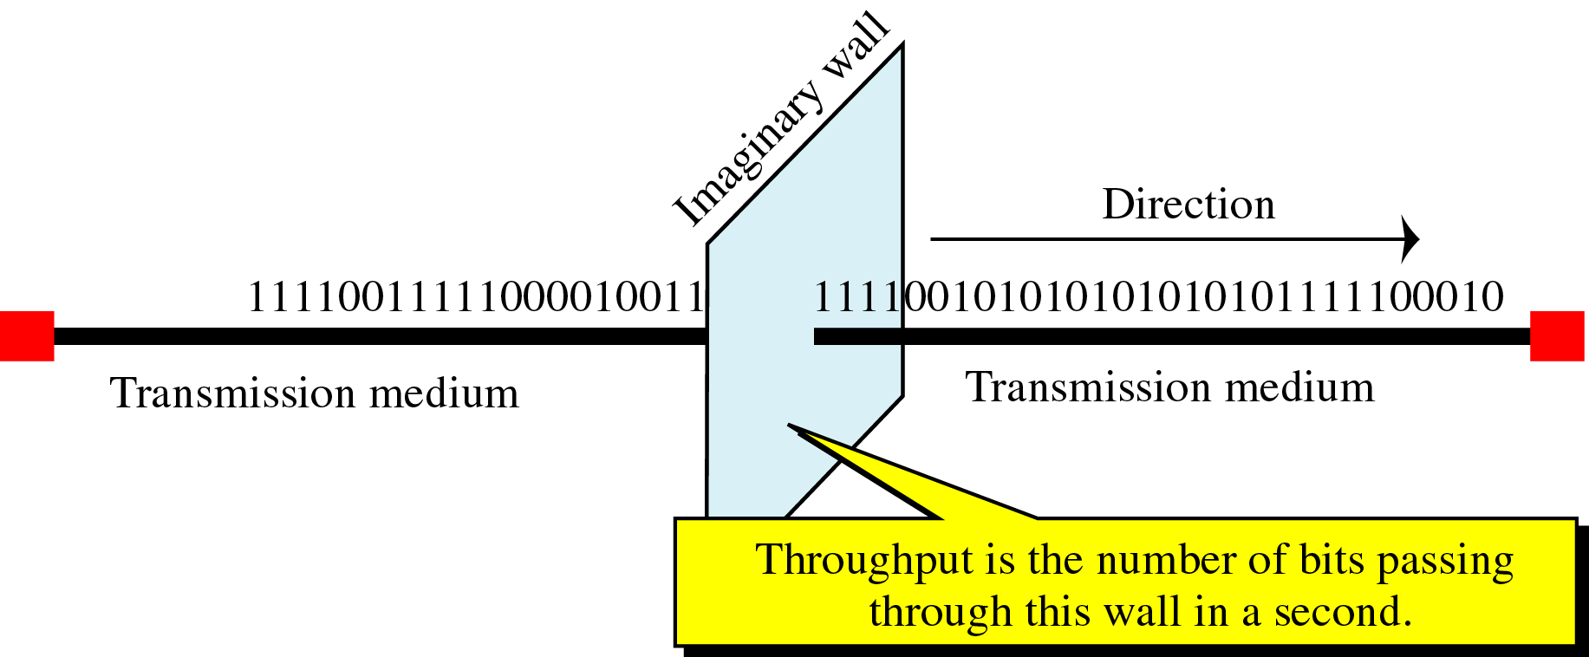
3. 6 Performance
Throughput
  is the measurement of how fast data can pass through a point

Slide 86

Performance (cont’d)
Example 3.44
A network with bandwidth of 10 Mbps can pass only an average of 12,000 frames per minute with each frame carrying an average of 10,000 bits. What is the throughput of this network?
Solution
We can calculate the throughput as
The throughput is almost one-fifth of the bandwidth in this case.

Slide 87
Performance (cont’d)
Latency (Delay)
  The latency or delay defines how long it takes for an entire message to completely arrive at the destination from the time the first bit is sent out from the source.
  Latency (지연) =propagation time(전파시간) + transmission time(전송시간)
  + queuing time(큐시간) +processing delay( 처리시간)
  Propagation time : The time required for a bit to travel from the source to the destination.
    Propagation time = distance / propagation speed
  Transmission time : The time between the first bit leaving the sender and the last bit arriving at the receiver.
    Transmission time = Message size / Bandwidth

Slide 88
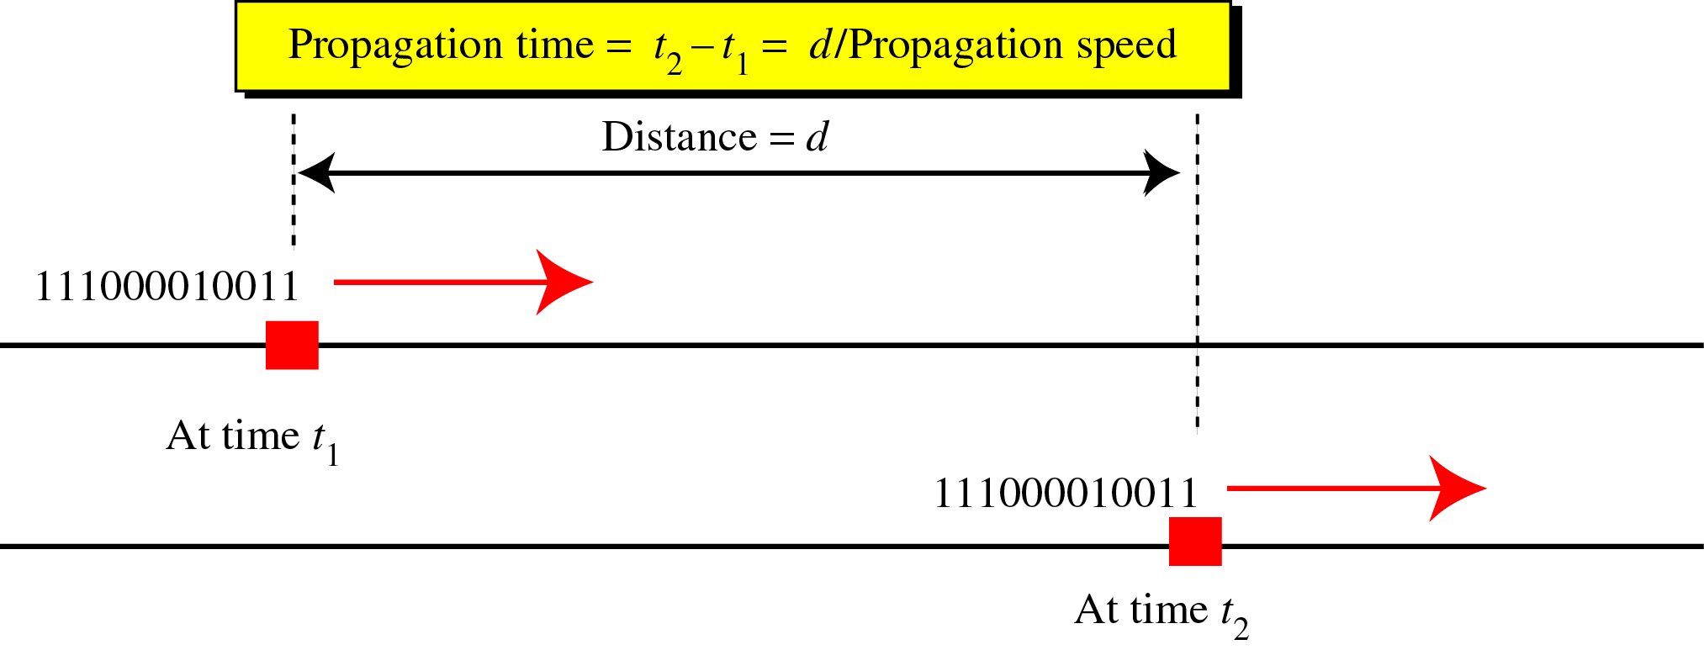
Performance (cont’d)
Propagation Time

Slide 89
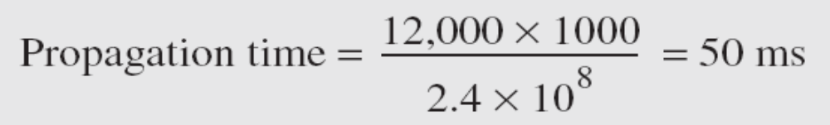
Performance (cont’d)
Example 3.45
What is the propagation time if the distance between the two points is 12,000 km? Assume the propagation speed to be 2.4 × 10⁸ m/s in cable.
Solution
We can calculate the propagation time as
The example shows that a bit can go over the Atlantic Ocean in only 50 ms if there is a direct cable between the source and the destination.

Slide 90
Performance (cont’d)
Example 3.46
What are the propagation time and the transmission time for a 2.5-kbyte message (an e-mail) if the bandwidth of the network is 1 Gbps? Assume that the distance between the sender and the receiver is 12,000 km and that light travels at 2.4 × 10⁸ m/s.
Solution
We can calculate the propagation and transmission time as shown on the next slide:

Slide 91

Performance (cont’d)
Example 3.46 (continued)
Note that in this case, because the message is short and the bandwidth is high, the dominant factor is the propagation time, not the transmission time. The transmission time can be ignored.

Slide 92

Performance (cont’d)
Bandwidth-delay Product
Figure 3.31 Filling the link with bits for case 1
The bandwidth-delay product defines the number of bits that can fill the link.

Slide 93

Performance (cont’d)
Bandwidth-delay Product
Figure 3.32 Filling the link with bits in case 2
4
4
4
4
4

Slide 94

Performance (cont’d)
Example 3.48
We can think about the link between two points as a pipe. The cross section of the pipe represents the bandwidth, and the length of the pipe represents the delay. We can say the volume of the pipe defines the bandwidth-delay product, as shown in Figure 3.33.
Figure 3.33 Concept of bandwidth-delay product

Slide 95
Summary(1)
Data must be transformed to electromagnetic signals to be transmitted.
Data can be analog or digital. Analog data are continuous and take continuous values. Digital data have discrete states and take discrete values.
Signals can be analog or digital. Analog signals can have an infinite number of values in a range; digital signals can have only a limited number of values.
In data communications, we commonly use periodic analog signals and nonperiodic digital signals.
Phase describes the position of the waveform relative to time 0.
A complete sine wave in the time domain can be represented by one single spike in the frequency domain.

Slide 96
Summary(2)
A single-frequency sine wave in not useful in data communications; we need to send a composite signal, a signal made of many simple sine waves.
According to Fourier analysis, any composite signal is a combination of simple sine waves with different frequencies, amplitudes, and phases.
The bandwidth of a composite signal is the difference between the highest and the lowest frequencies contained in that signal.
A digital signal is a composite analog signal with an infinite bandwidth.
Baseband transmission of a digital signal that preserves the shape of the digital signal is possible only if we have a low-pass channel with an infinite of very wide bandwidth.

Slide 97
Summary(3)
If the available channel is a bandpass channel, we cannot send a digital signal directly to the channel; we need to convert the digital signal to an analog signal before transmission.
For a noiseless channel, the Nyquist bit rate formula defines the theoretical maximum bit rate. For a noisy channel, we need to use the Shannon capacity to find the maximum bit rate.
Attenuation, distortion, and noise can impair a signal.
Attenuation is the loss of a signal’s energy due to the resistance of the medium.
Distortion is the alteration of a signal due to the differing propagation speeds of each of the frequencies that make up a signal.
Noise is the external energy that corrupts a signal.

Slide 98

Q & A

